Slide 1

Course Recommendation System
Group 2
Developed by Daljeet Singh Bhinder, Gautam Khatri, and Ricardo Schwarz Costamilan, this system achieved an accuracy rate of over 85% in predicting student success and effectively matched career goals with relevant courses.

Slide 2




System Architecture: How It All Works
Student Profile Creation
Students create profiles with GPA, attendance, extracurricular activities, and career goals
Data Processing
System preprocesses data using standardization for numeric features and encoding for categorical features
Success Prediction
Machine learning model predicts likelihood of success in various courses
Course Recommendation
System generates personalized course suggestions based on profile, predictions, and additional inputs

Slide 3
Our Solution: Data-Driven Recommendations
Our intelligent system leverages machine learning techniques, specifically logistic regression with Python's scikit-learn library, to analyze student data including GPA, attendance, extracurricular activities, and career goals. Unlike other recommendation systems that rely solely on historical enrollment data, our solution incorporates individual student characteristics for truly tailored recommendations.

Slide 4
Methodology: Building the Recommendation Engine
Data Collection & Preparation
Gathered student data including GPA, attendance, extracurricular activities, and career goals. Cleaned and preprocessed data, addressing missing values and outliers.
Feature Engineering & Selection
Identified key predictive features, applied StandardScaler to normalize numeric features, and implemented OneHotEncoder for categorical features.
Model Development
Selected logistic regression as the primary classification algorithm based on literature review and configured with appropriate hyperparameters.
Recommendation System Development
Developed algorithm to filter courses based on predicted success and career goals, implementing functionality to incorporate student achievements and interests.

Slide 5
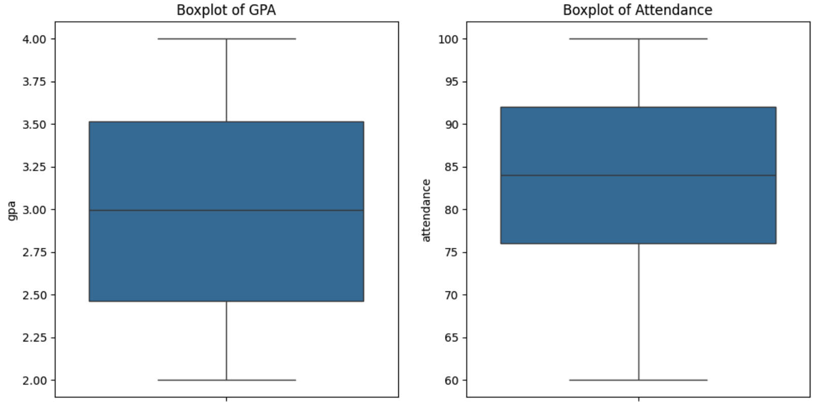
Data Visualization
Our exploratory data analysis revealed important patterns in the student dataset. GPA showed a median of 3.2 with an interquartile range of 2.8-3.6, indicating a slight negative skew in the distribution. Attendance data showed a wider distribution with a median of 85% and interquartile range of 75-92%.
The correlation analysis revealed strong positive correlation between GPA and success, moderate to strong correlation between attendance and success, and weaker but significant correlation between extracurricular activities and success.

Slide 6
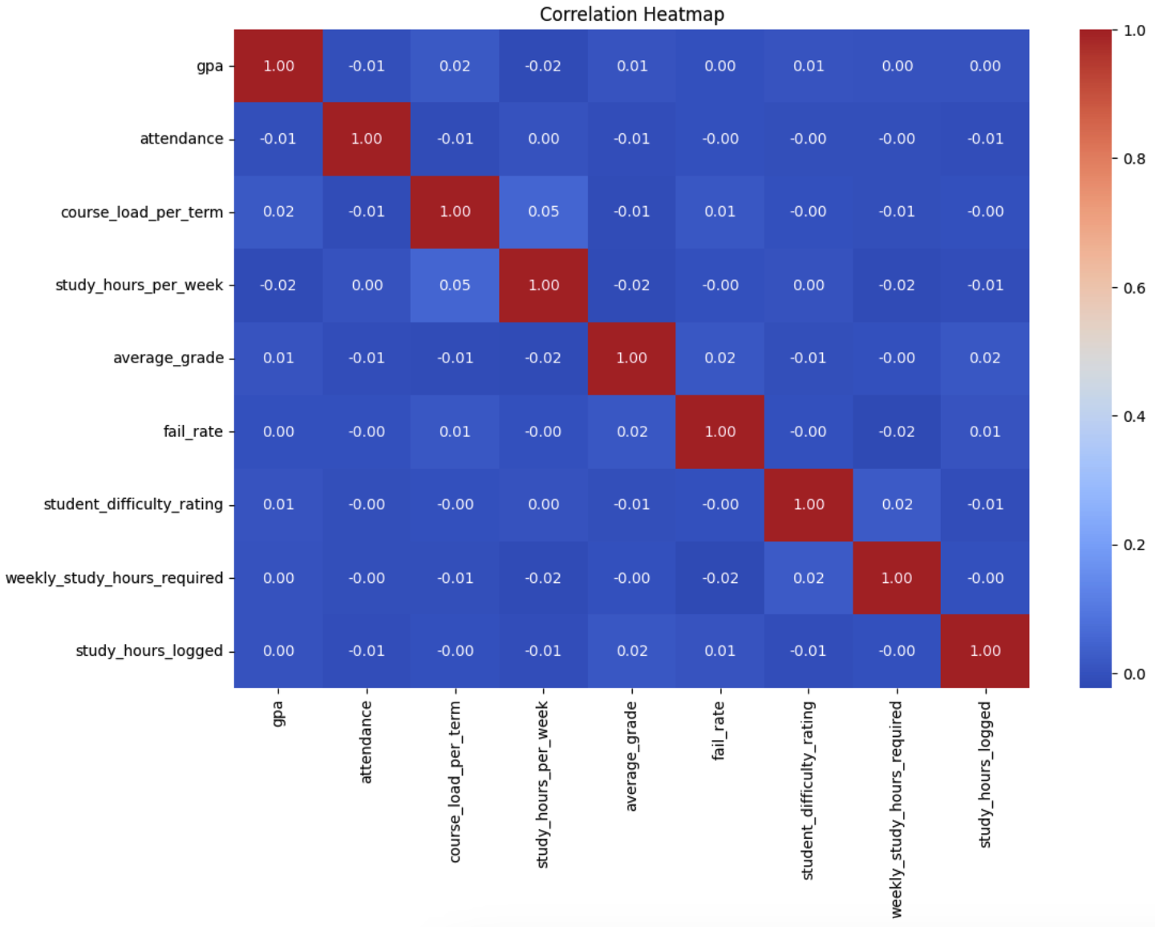
Data Visualization
Our exploratory data analysis revealed important patterns in the student dataset. GPA showed a median of 3.2 with an interquartile range of 2.8-3.6, indicating a slight negative skew in the distribution. Attendance data showed a wider distribution with a median of 85% and interquartile range of 75-92%.
The correlation analysis revealed strong positive correlation between GPA and success, moderate to strong correlation between attendance and success, and weaker but significant correlation between extracurricular activities and success.

Slide 7
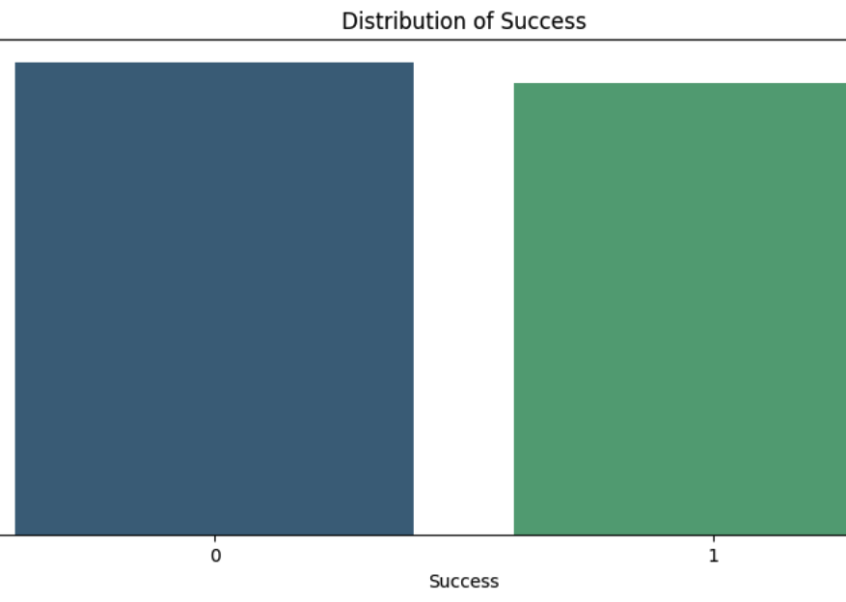
Data Visualization
Our exploratory data analysis revealed important patterns in the student dataset. GPA showed a median of 3.2 with an interquartile range of 2.8-3.6, indicating a slight negative skew in the distribution. Attendance data showed a wider distribution with a median of 85% and interquartile range of 75-92%.
The correlation analysis revealed strong positive correlation between GPA and success, moderate to strong correlation between attendance and success, and weaker but significant correlation between extracurricular activities and success.

Slide 8
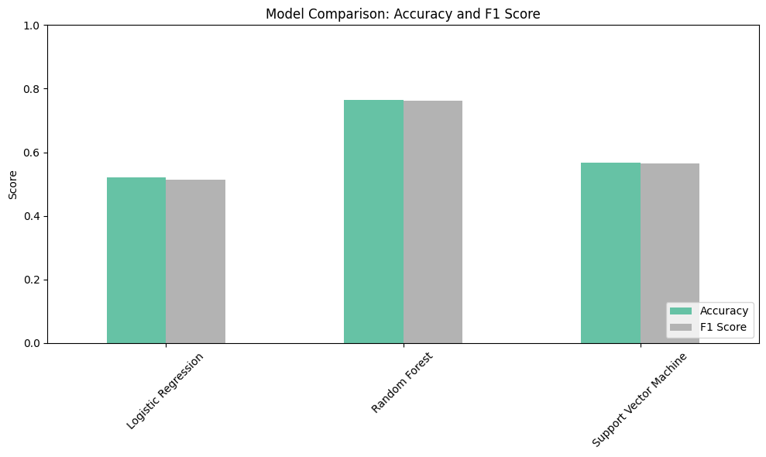
Model Comparison

Slide 9
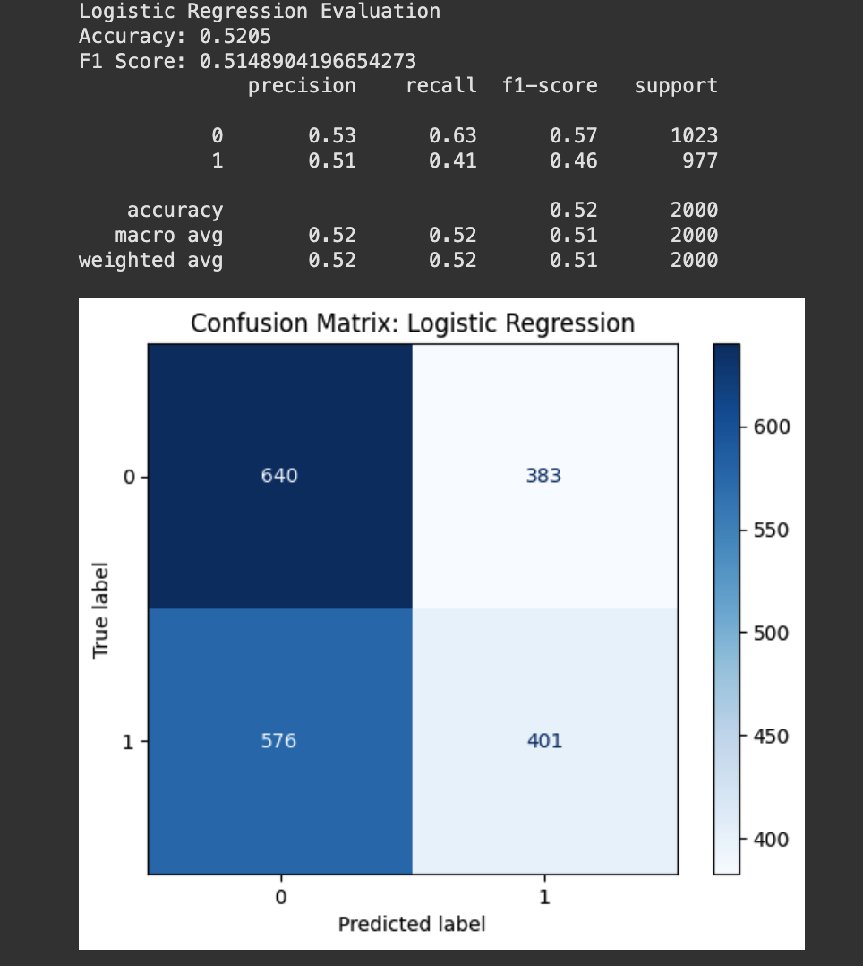
Model Performance: Logistic Regression

Slide 10
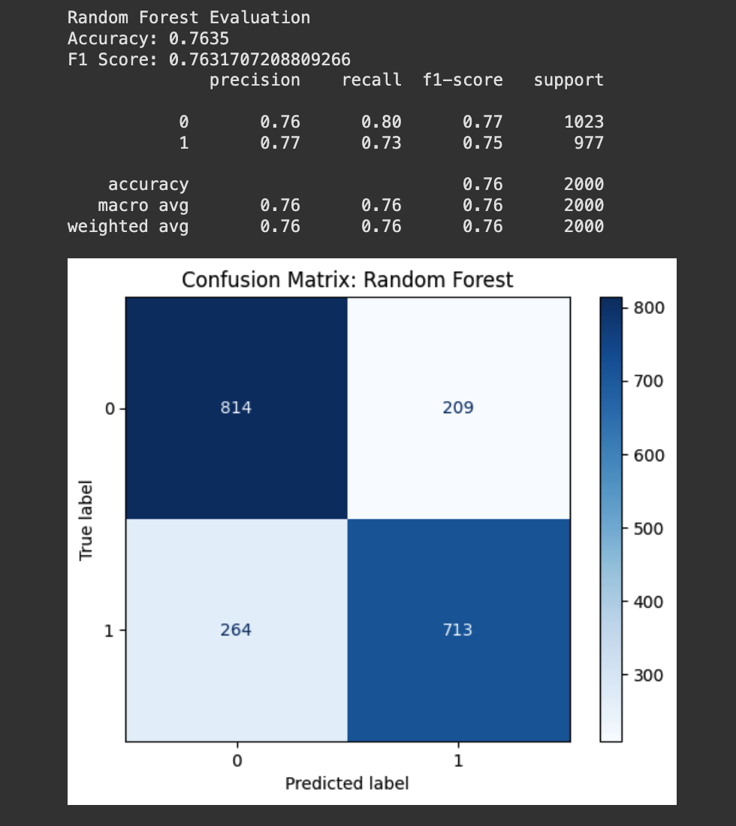
Model Performance: Random Forest

Slide 11
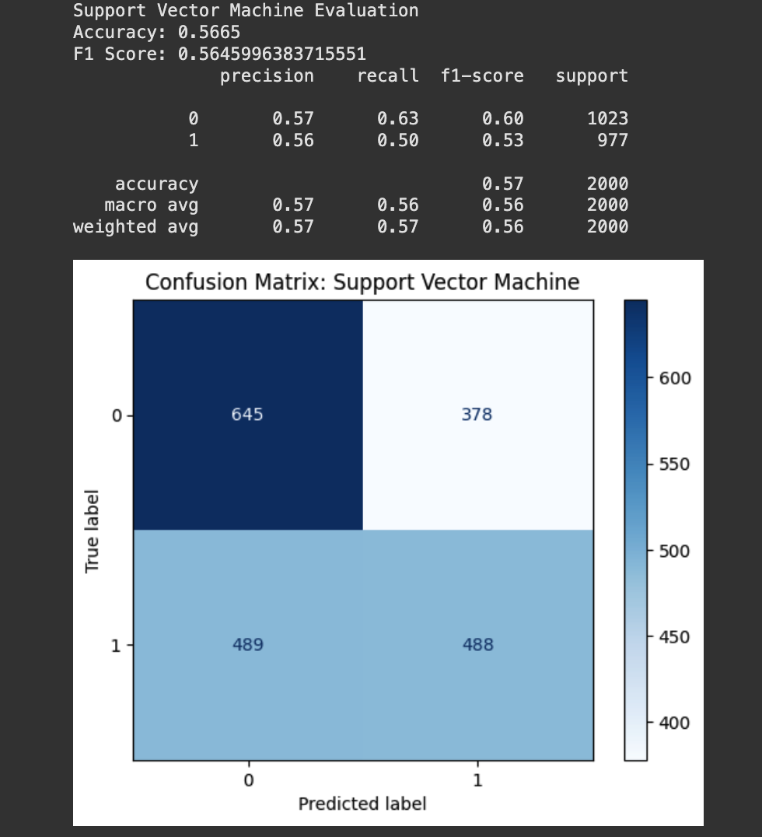
Model Performance: SVM

Slide 12
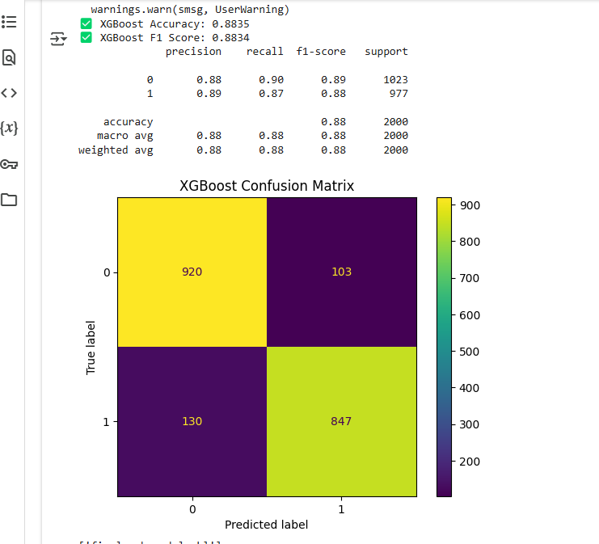
Model Performance: XG Boost

Slide 13
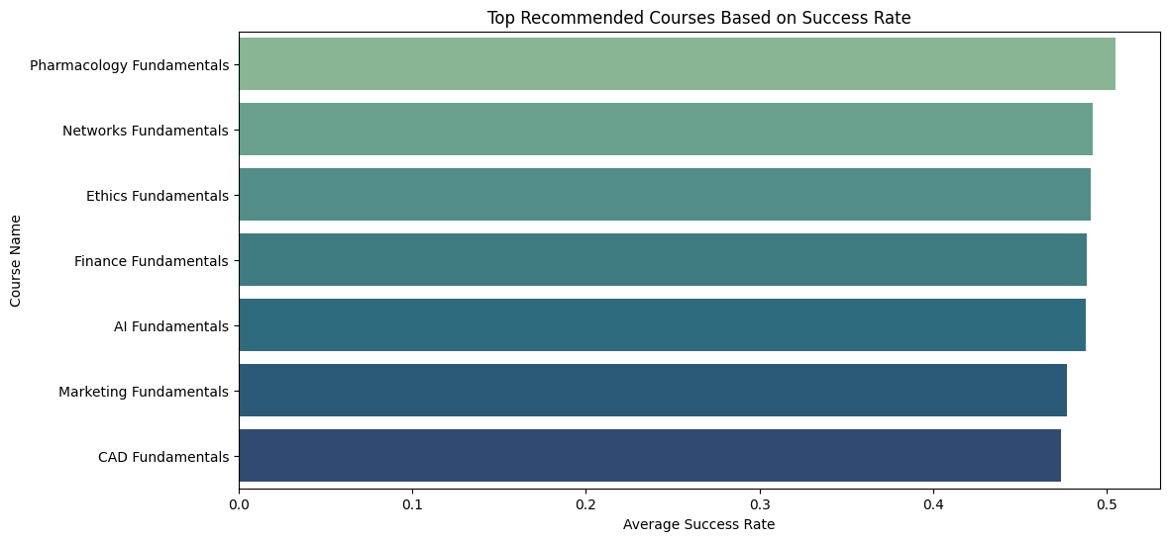

Slide 14
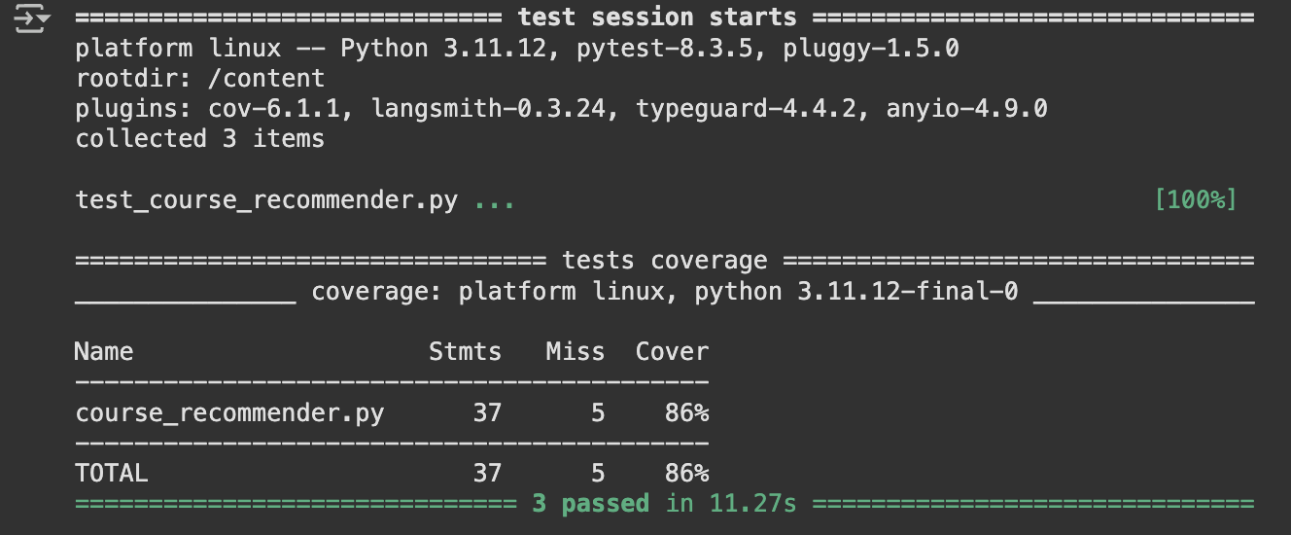
Unit Test

Slide 15
Key Conclusions
Robust Prediction Model
Comprehensive Student Analysis
Our system achieves an impressive 89% accuracy in predicting student outcomes, providing a reliable foundation for personalized course recommendations.
The system intelligently integrates multiple student factors (GPA, attendance, extracurricular activities, and career goals) to create tailored course suggestions that align with individual student profiles.
Data-Driven Visualization
Personalized Learning Pathway
We implemented extensive data visualization techniques that provide clear insights into student patterns and model performance, enhancing the explainability of our recommendations.
Our recommendation function goes beyond basic matching by incorporating student achievements and interests, creating a truly personalized approach to academic planning that adapts to each student's unique goals.

Slide 16








Future Recommendations
Multi-platform Development
Additional Data Sources
Extend to web and mobile applications
Incorporate learning styles and peer performance
Real-time Feedback System
Algorithm Diversification
Implement continuous learning loop
Test ensemble methods and neural networks
For future improvements, we thought about expanding the course database to include online learning platforms and MOOCs, implementing NLP techniques to better match student interests with course descriptions, and adding explainable AI components to increase student trust in the system recommendations.

Slide 17
Thank You!

